Slide 1



FINTECH: REVOLUTIONIZING FINANCIAL SERVICES VIA DESIGN AND TECHNOLOGY
Data and Business Analytics
SE SSI O N S 13 & 14
Demystifying blockchain and cryptocurrency - Crypto 101
Manoel Gadi
Fall 2022

Slide 2
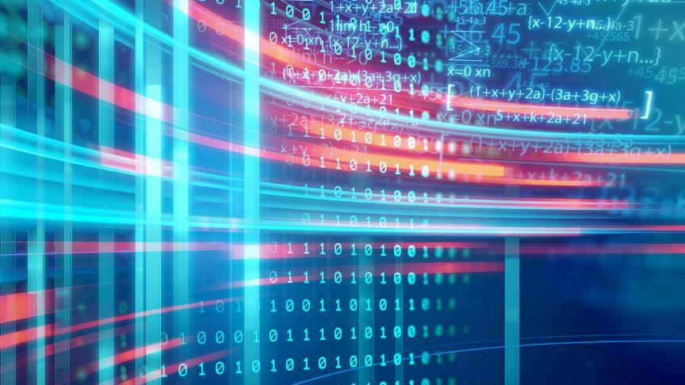
Bitcoin and Blockchain are evolutions in Technology, let’s see some recent evolutions: From Computers to the Cloud Computing and beyond!

Slide 3
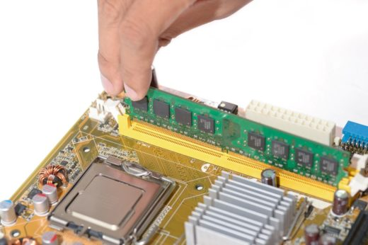
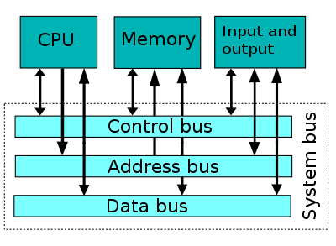
Past...
high latency
… the closer to the CPU
the better ...

Slide 4
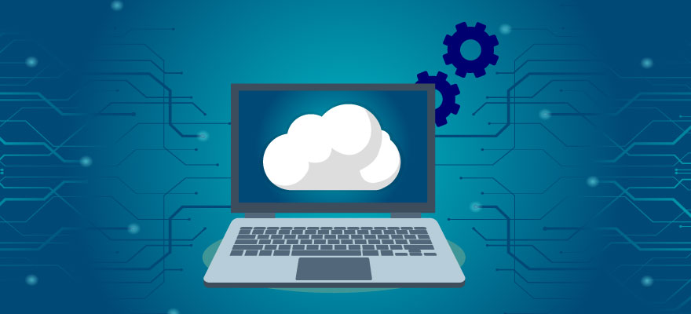
But latency is reducing drastically with optical fiber ...
Hard disk and CPU "outside" of my computer

Slide 5

What is cloud computing
In simple words, Cloud computing is a service that lets you use any computing service such as a server, storage, networking, databases, and intelligence, right through your browser without owning anything. You can do anything you can think of unless it doesn’t require you to stay close to your hardware to use it like you can’t do document scanning or printing because it requires you to stay close to your printer.

Slide 6
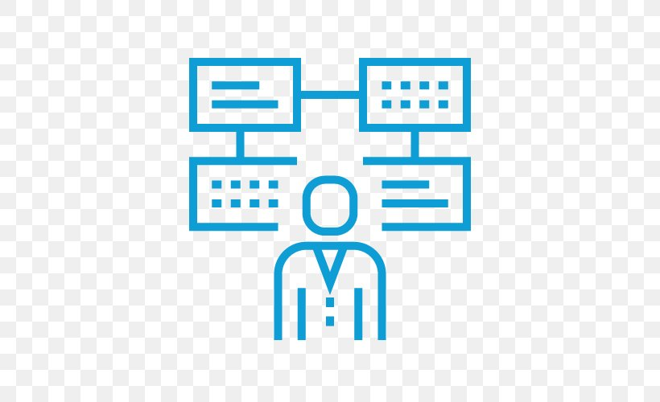
Use cases for Cloud Computing?
How can companies benefit (profit) from it?

Slide 7
Cloud computing Use cases
Infrastructure as a Service
With cloud computing, you can offer your clients the use of your infrastructure to host their cloud services.
Platform as a Service
You can offer your platform to clients through cloud computing.
Most online platforms run on cloud computing today, because they are available to anyone with a connection.
Companies are rapidly moving to the cloud to eliminate the need for computer hardware in their own offices decreasing their IT cost.
File Storage
You can store pretty much any type of file on the cloud, and if you need limited access to your files, private cloud services can be made highly secure
Data Backup
While you can backup to your computer or a drive, either of these can be physically damaged in a storm, flood or fire. The cloud offers you a place to backup data that is away from your location and will keep data safe in a secure environment

Slide 8
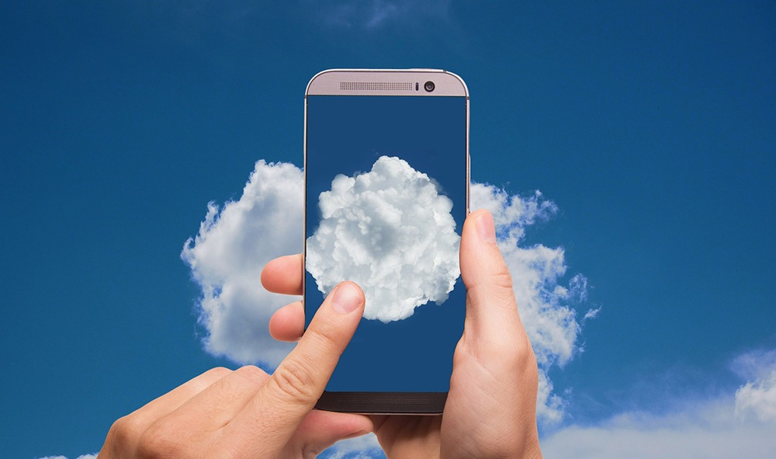
But latency is reducing drastically in Mobile too ...
Hard disk and CPU "outside" of my Mobile

Slide 9
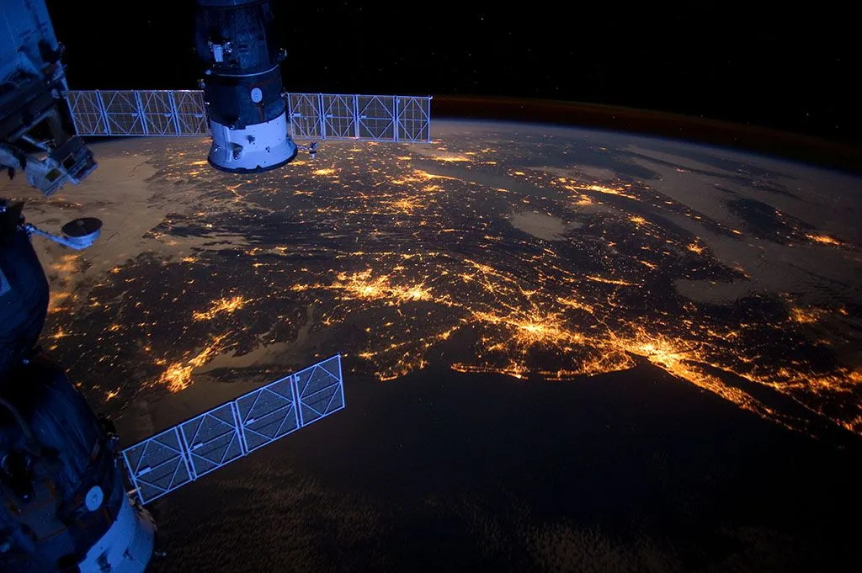
The fifth-generation 5G technology
The 5G technology is the next important phase of the global telecommunication evolution.
It has been successfully deployed in several areas of different industries.
The major features of the 5G cellular networks are enhancing the mobile broadband, enabling the device-to-device (D2D) communication, and the provisioning of the ultra-reliable low-latency communication services.
5G is a solution to meet the demand of the ever-growing user traffic and fulfil, the requirements of the low-latency device-to-device communication in the different technology sectors like manufacturing, robotics, automobile, shipping, transportation, retail, etc

Slide 10
Use cases for 5G?
How can companies benefit (profit) from it?

Slide 11
5G Use Cases
Connecting millions of devices
The connection of millions of devices in a small area, thanks to MIoT (Massive Internet of Things), is one of the most important developments.
Extending the service life of sensors
Some of the features of 5G can reduce battery consumption by up to 50% over current consumption
Improved security protocols
5G provides a higher degree of confidence with enhanced security protocols, and also ensures network ubiquity, i.e. seamless coverage.
Exclusive network portions
Critical infrastructure operators may apply the concept of network slices and have their own communications infrastructure.
Safe decisions and close to the sensors
The increase in the volume of information available, together with edge computing technology, will make it possible to define algorithms to make secure decisions close to the sensors that generate the information.
Real-time remote control
In Industry 4.0. or smart factories, autonomous operation of irrigation and plants, as well as robot control via 5G, will become commonplace.
Remote technical support
Augmented reality calls are presented as an interesting alternative to face-to-face technical support, avoiding the travel of experts and making it possible to access highly specialised knowledge from anywhere in the world.

Slide 12
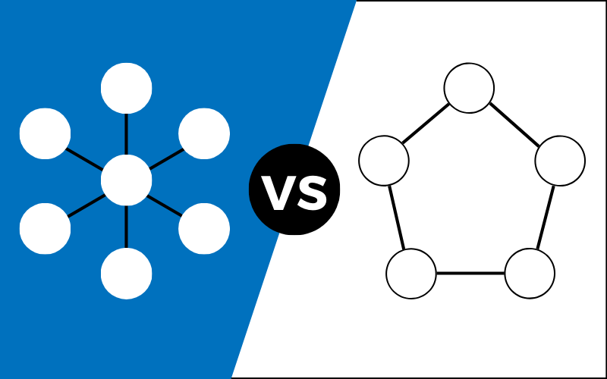
But speed is not all on internet ...
Centralization vs. Decentralization

Slide 13
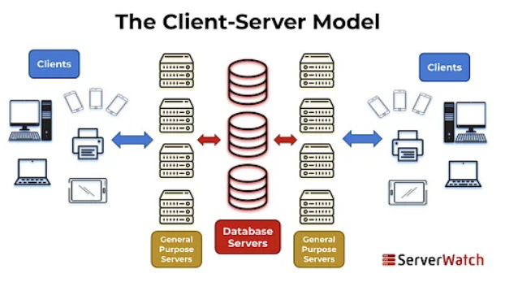
Web 2.0
Typically, a server is a fairly powerful machine with specific hardware and software that acts as a data repository and functions as a database or application management system.
In this architecture, the client is usually a workstation that requests various services from the server, while a server is a machine that acts as a data repository and functions as a database management system, which is responsible for providing the response demanded by the client.

Slide 14
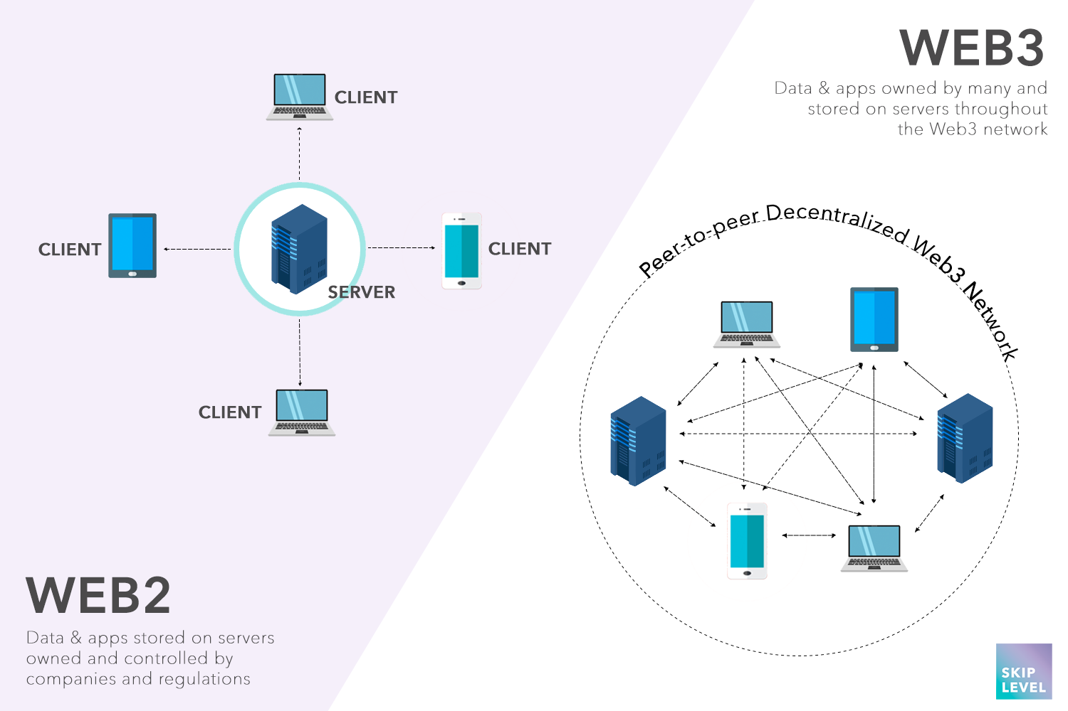
Web 3.0
Web 3.0 is the most current type of internet, whose main characteristics are democratisation and based on semantic web technology. It is built on a decentralised blockchain where there is no centralised ownership of content or platforms.

Slide 15
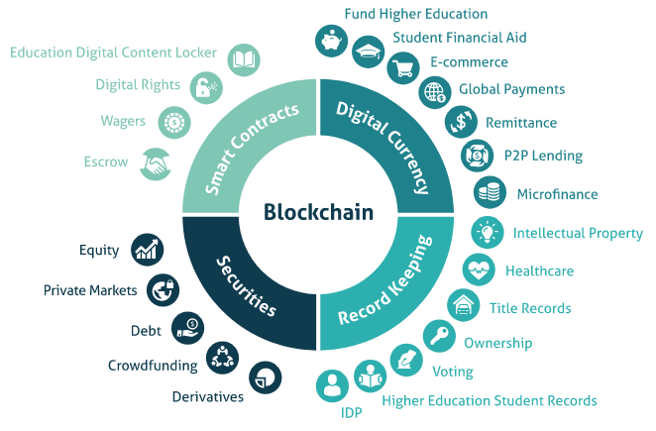
Blockchain and its potential
Blockchain technology is the technological infrastructure and protocols that enable the simultaneous access, validation and updating of records in an immutable way across a network that spans across multiple entities or locations.
Blockchain is gradually being introduced in almost all industries to manage various complex problems such as:
Payment systems
Verification of certificates and legal documents
Supply chain
The e-KYC process
Energy distribution and billing
The possibility of integrating blockchain to other technologies that are also emerging such as 5G, AI/ML, Cloud, and Edge Computing to regularise various complex issues in the telecom sector makes it even more interesting.

Slide 16
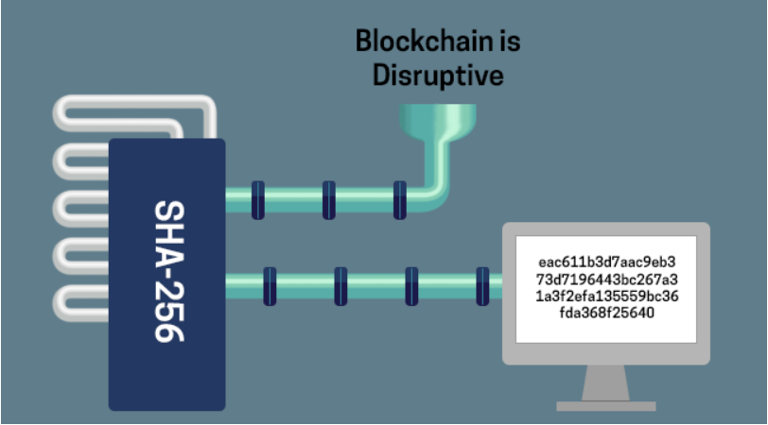
Blockchain Definition
"By definition, Blockchain is a consensus-based, secured decentralized public/private ledger which stores information immutably over a peer-to-peer network.“
It does this by storing data within blocks in the form of cryptographically immutable transactions.

Slide 17
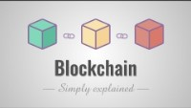
Blockchain, How it works

Slide 18
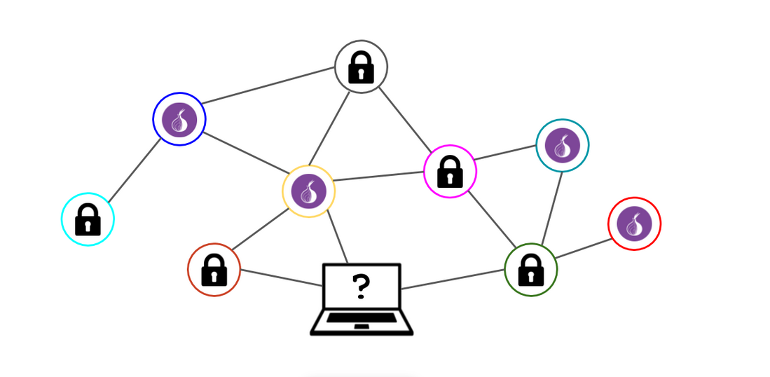
Blockchain and its potential
Invented in 1991 to emulate a notary, it was not used until Satoshi Nakamoto, in 2009, created Bitcoin.
It was introduced by Bitcoin, and given its potential across industries and sectors.
Blockchain is one of the emerging technologies in the world today.
It has to do with the idea of a decentralised network as opposed to the conventional centralised mechanism.

Slide 19
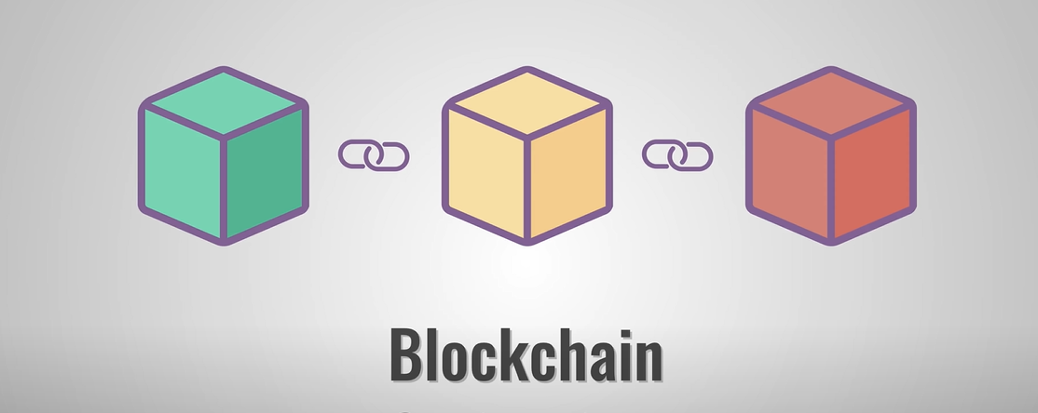
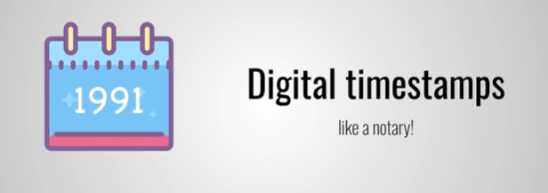
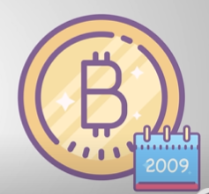
What is a blockchain?
Invented in 1991 to emulate a notary, unused until Satoshi Nakamoto in 2009 created Bitcoin.

Slide 20
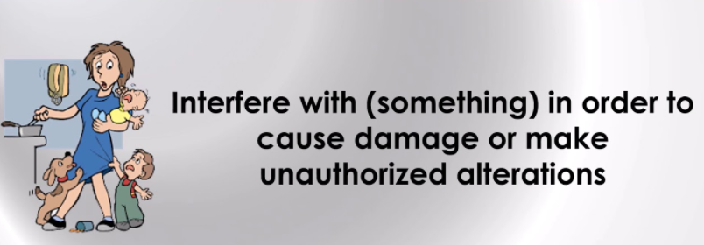
Secure
Impossible to backdate or tamper.
Tamper

Slide 21
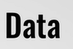
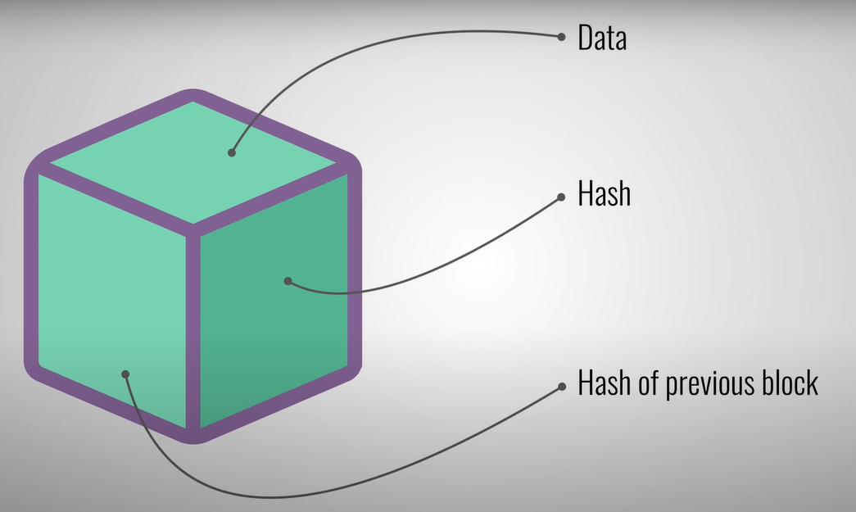
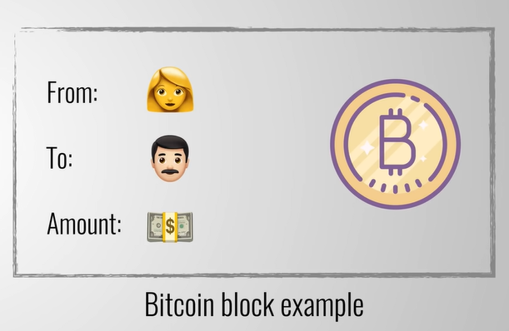
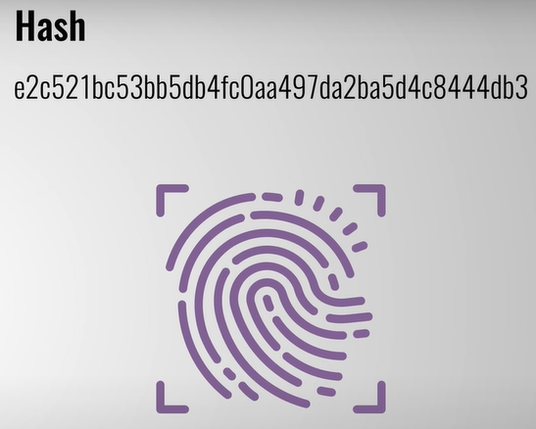
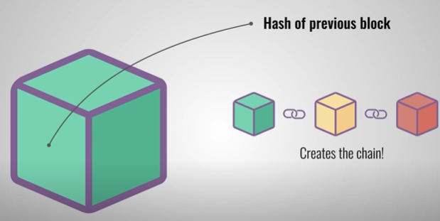
The block
BitCoin data:
sender
receiver and
ammount
Hash is unique and is
calculated based on all information in the block.
Including the hash of
the previous block.

Slide 22
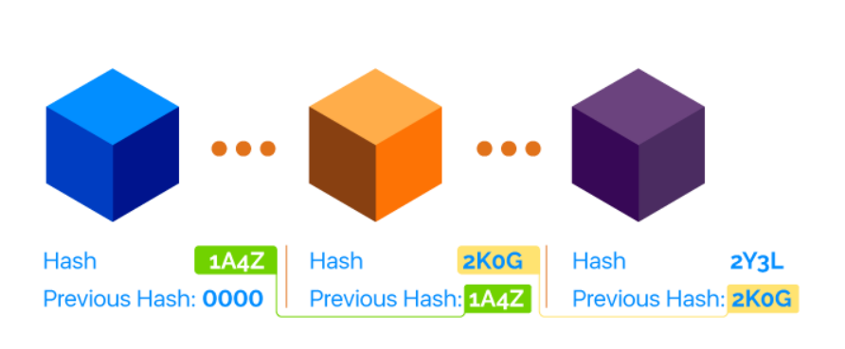
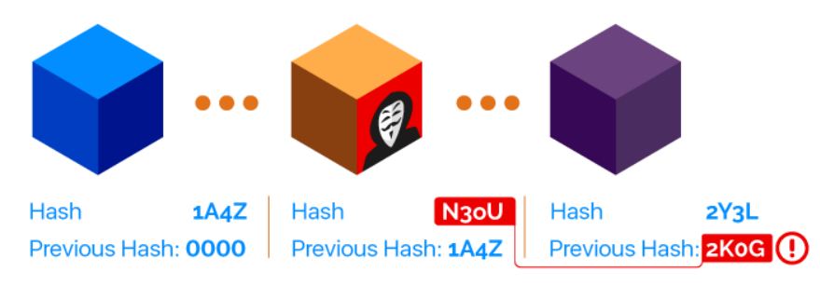
Blockchain Security
Technically, a blockchain is a chain of ordered blocks in a network of untrusted peers. Each block references the previous block and contains data, its own hash and the hash of the previous block.
If anyone changes the data in a single block, the hash of that particular block changes, but it also makes the whole chain invalid.

Slide 23
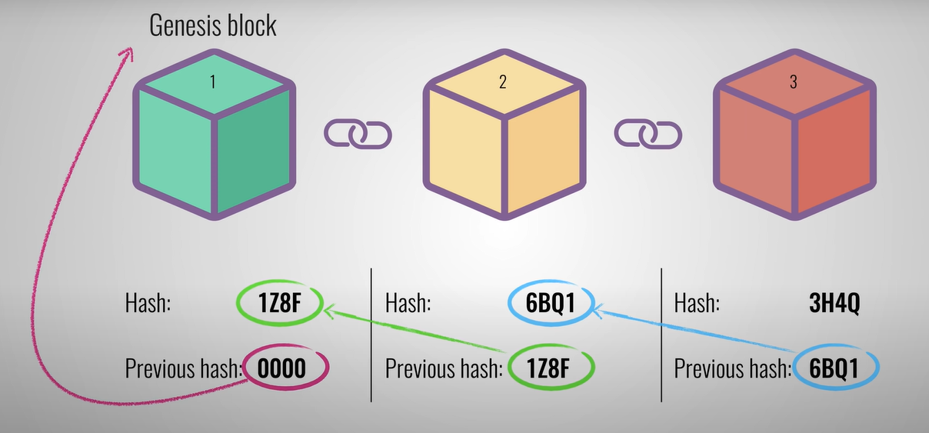
The chain

Slide 24
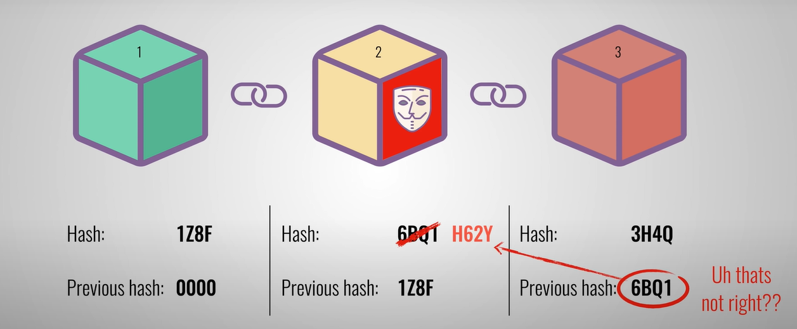
Tampering
How does blockchain avoid someone tampering a block and recalculating the whole chain again?
Using 'Proof of work' to slow down the creation of new blocks.
Using central entity to manage the chain, like the exchanges.
Allowing all people to join the chain and record the previous blocks, the consensus from these people(recorders) is the valid chain.
Using Hash value to link front and back blocks.

Slide 25
Tampering
How does blockchain avoid someone tampering a block and recalculating the whole chain again?
Using 'Proof of work' to slow down the creation of new blocks.
Using central entity to manage the chain, like the exchanges.
Allowing all people to join the chain and record the previous blocks, the consensus from these people(recorders) is the valid chain.
Using Hash value to link front and back blocks.

Slide 26
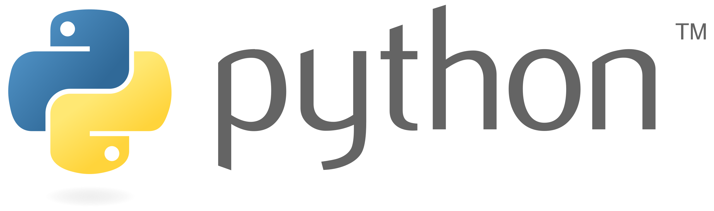
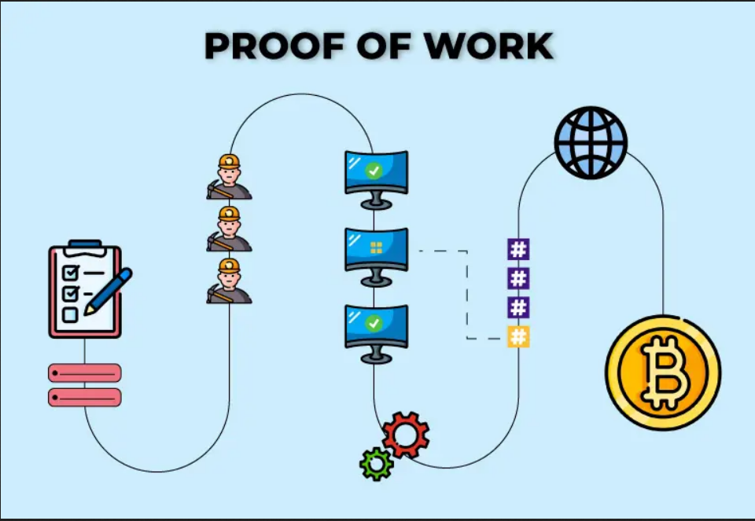
How does blockchain avoid someone tampering a block and recalculating the whole chain again?
Using 'Proof of work' to slow down the creation of new blocks.
Using central entity to manage the chain, like the exchanges.
Allowing all people to join the chain and record the previous blocks, the consensus from these people(recorders) is the valid chain.
Using Hash value to link front and back blocks

Slide 27
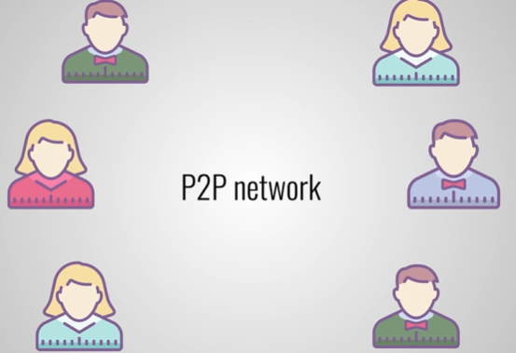
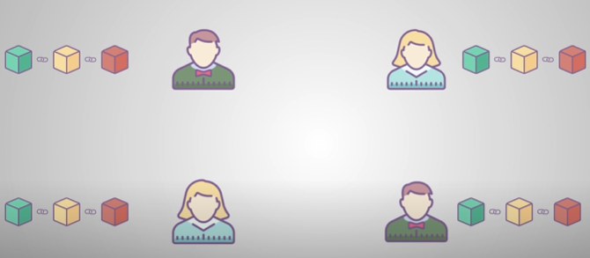
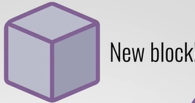
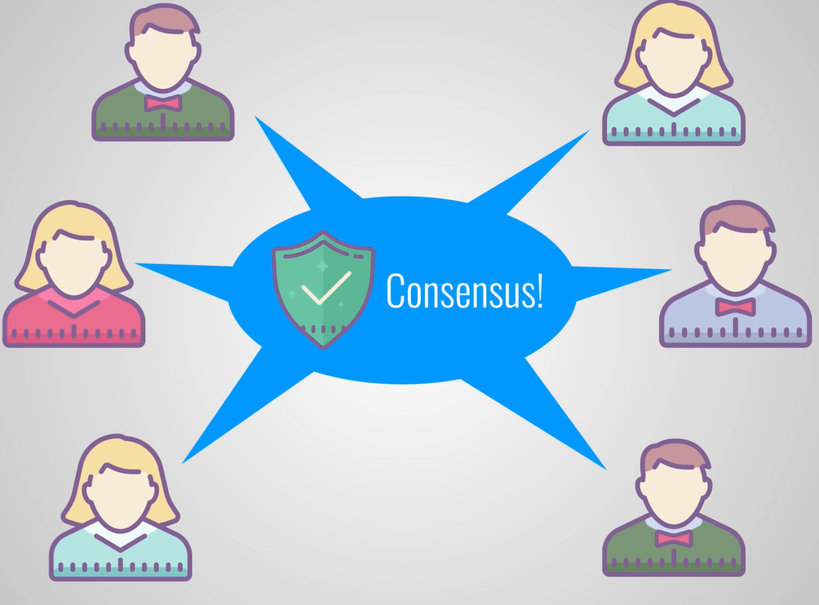
P2P network
Bitcoin - join and receive a full copy of the chain:
An attacker requires more than 50% of the network for the
new block to be accepted.

Slide 28
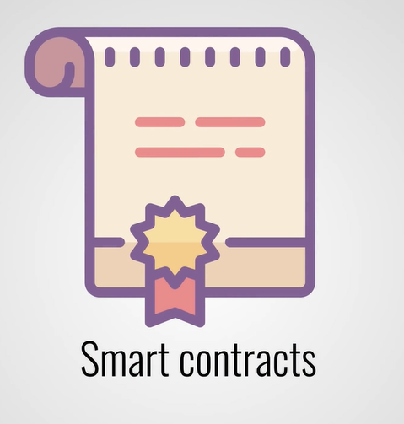
Smart contracts

Slide 29
Use cases for Blockchain?
How can a companies benefit (profit) from it?

Slide 30
Blockchain Use cases
Cryptocurrencies and tokens:
The main use case for blockchains is the support of cryptocurrencies and tokens.
Healthcare:
The blockchain database architecture is ideal for storing medical records.
Users receive permanent storage of medical records wherever there is an internet connection.
They can share access with doctors and insurance companies with a simple online transaction.
Decentralised finance
Innovative DeFi applications can track secure transactions while eliminating the need for slow and costly intermediaries.
The blockchain maintains a history of previous transactions for auditors
Supply chain management:
The blockchain can play a key role in tracking products throughout their journey from creation to use.
Insurance settlements:
Blockchain-based applications can eliminate the risk of fraud while streamlining loss reimbursement in the insurance industry.
Blockchain voting
With blockchain voting, the verification of the voter's identity is guaranteed with cryptographic security.
The blockchain network can monitor the vote, tally it and guarantee the integrity of the result.
Media and communications:
Both artists and production companies complain about piracy.
Blockchain-based distribution could make each copy of a digital media file unique
And provide a convenient mechanism where viewers make micro-payments directly to creators or production companies.

Slide 31
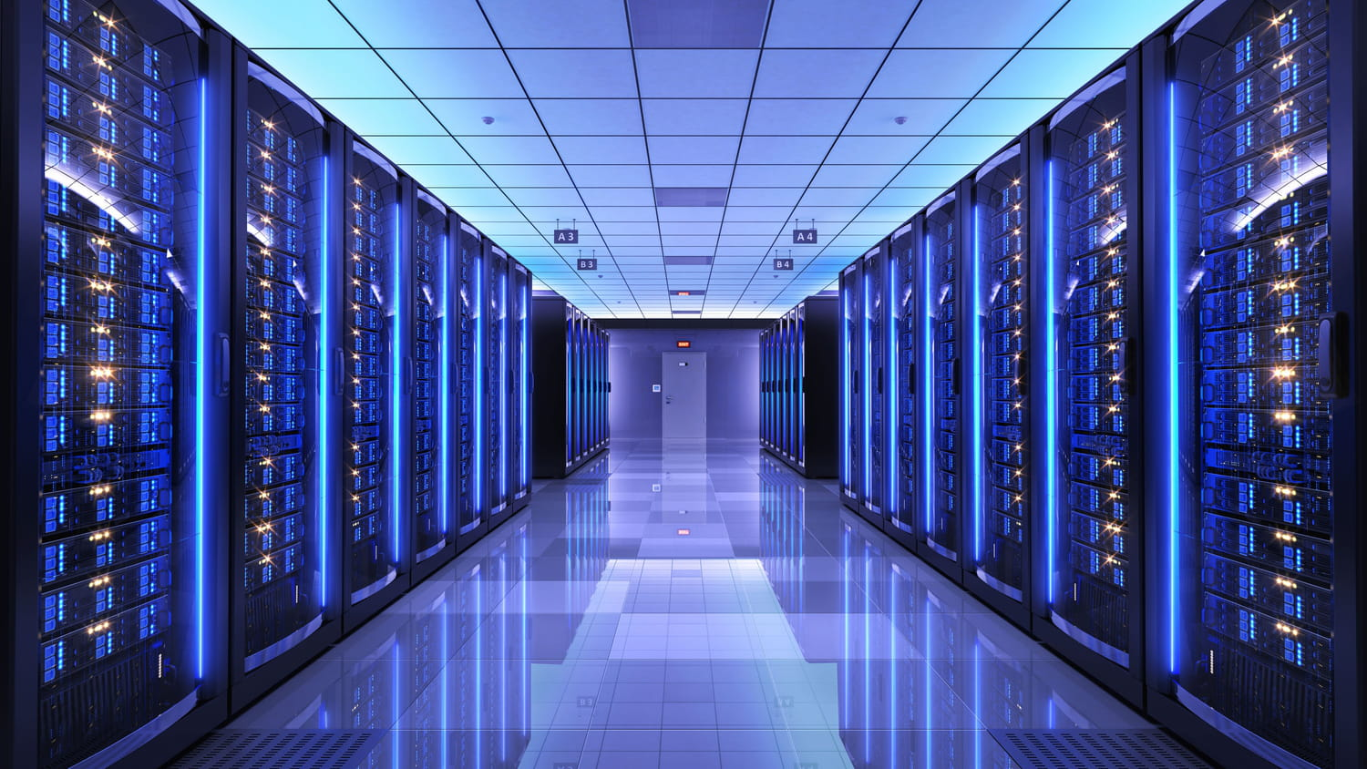
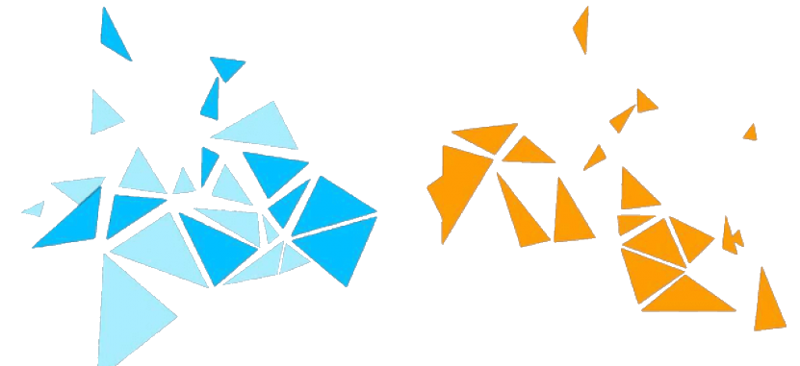
Cloud Computing with blockchain
Integrating the blockchain with cloud computing is a probable solution to
address the preceding security bleaches in the cloud-based 5G network. A
blockchain is employed to build a verification platform between the IoT devices
while exchanging the data, BBU unit, and manufacturer, where the user access
information is stored immutably on the chain, while the smart contracts carry out the automatic user authentication.

Slide 32
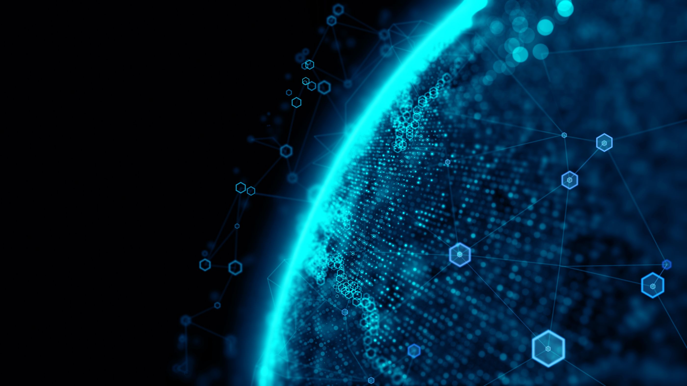
Integration blockchain with 5G
5G technology thanks to its low latency and increased connectivity could make Blockchain more scalable while allowing greater node participation. With 5G, Blockchains could become ubiquitous and could become more efficient due to the data processing speed that could be brought.
There is a huge potential in the blockchain technology for supporting the 5Genabled technologies such as secure cloud and edge computing, D2D communication, and network slicing, and it has also the potential for efficient spectrum sharing, resource management, and facilitation of the global 5G services.

Slide 33
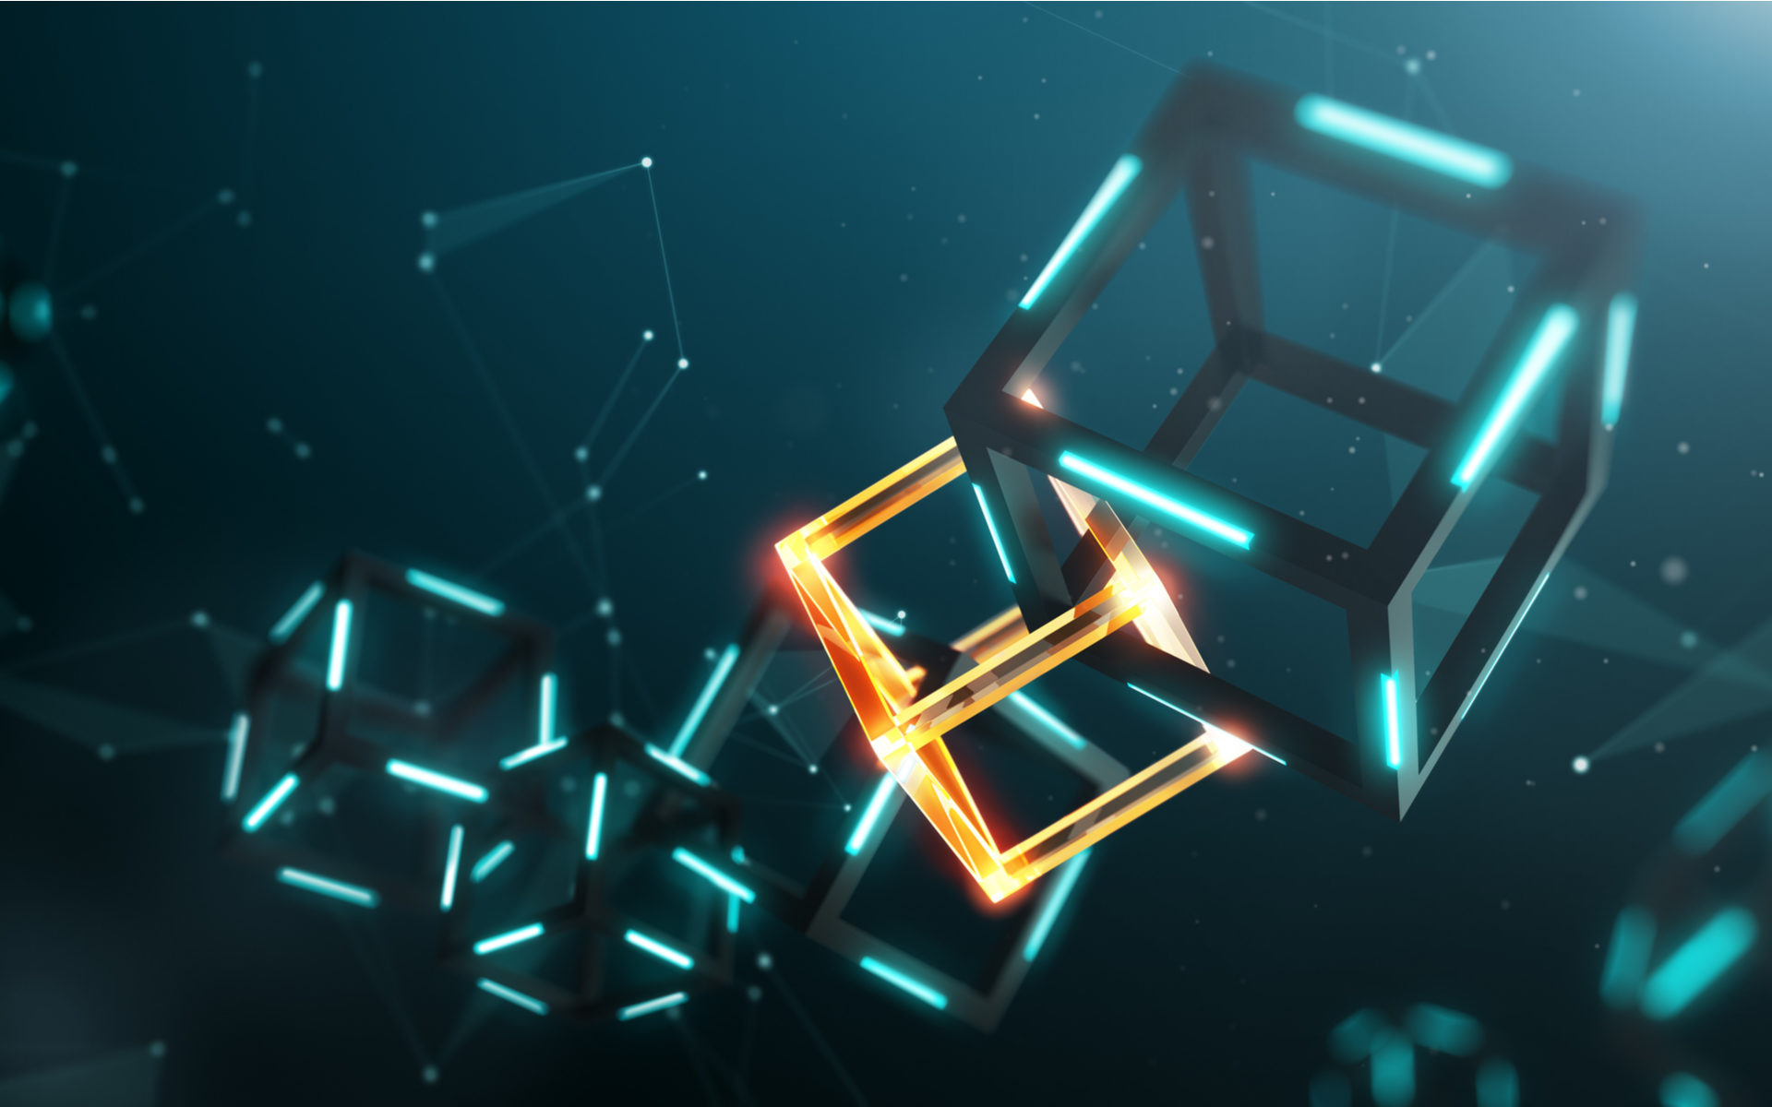
Blockchain, 5G and IOT the perfect storm
With 5G and blockchain, all the ingredients have now come together for IoT to take off.
Secure machine identity and Blockchain attributes such as trust, immutability or non-repudiability come to mind first. We also have a growing number of next-gen smart connected devices at home with their own processing and storage capacities.
5G’s improved and ubiquitous connectivity allows services to be delivered with a combination of IoT and the Cloud to get smarter by the day.
Better industrial processes are now possible thanks to smarter sensors and the programmability of Smart contracts.

Slide 34
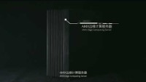
First 5G Edge computing server powered by blockchain

Slide 35
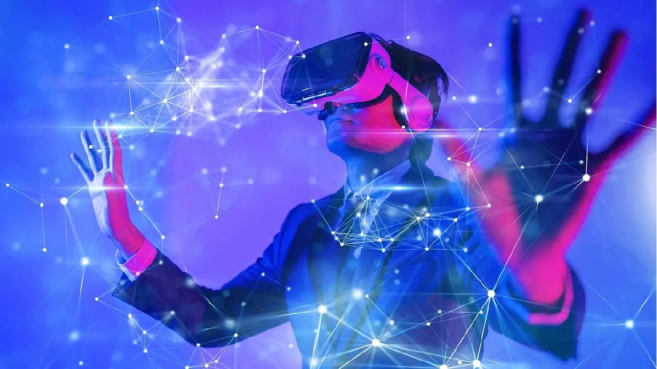
What about the Metaverse?
Is a new virtual and three-dimensional (3D) ecosystem in which users can interact with each other, work, play, study, carry out economic transactions, among many other possibilities.
People use avatars to represent themselves, communicate, and virtually expand the community in the metaverse.

Slide 36
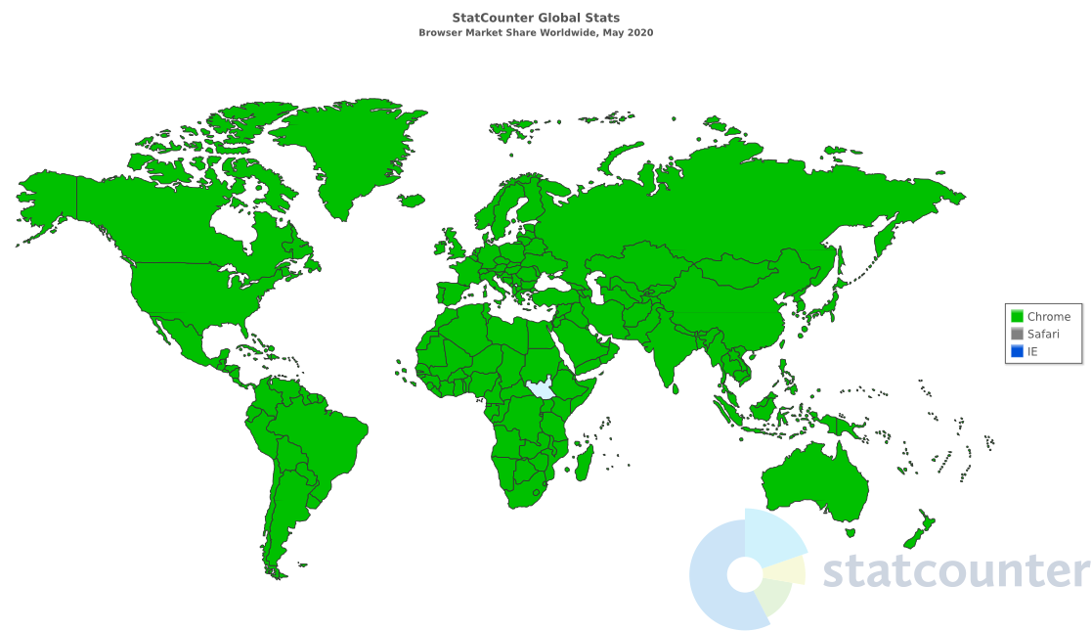
Browser Wars
Browser war is competition for dominance in the usage share of web browsers.
The "The first browser war," (1995-2001) pitted Microsoft’s Internet Explorer against Netscape's Navigator. Browser wars continued with the decline of Internet Explorer's market share and the popularity of other browsers including Firefox, Google Chrome (and other Chromium-based browsers), Safari, Microsoft Edge and Opera.
https://en.m.wikipedia.org/wiki/Browser_wars

Slide 37
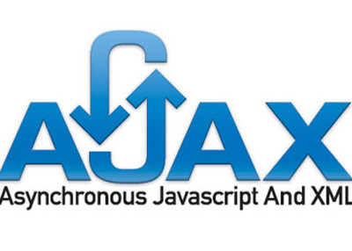
AJAX :
Asynchronous JavaScript And XML

Slide 38
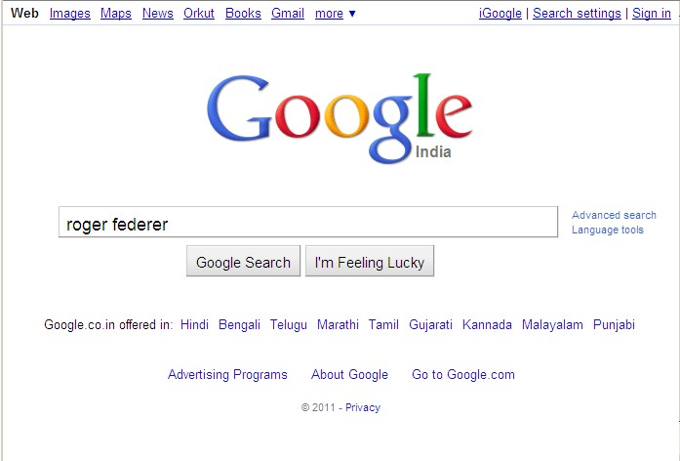
ANTES
Click Search

Slide 39
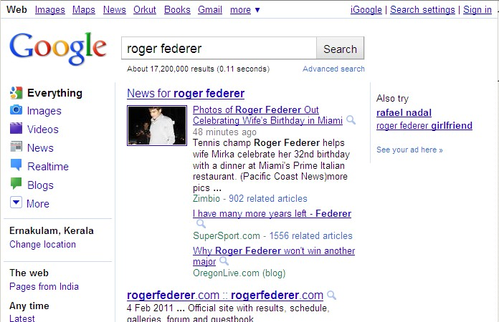
RESULT:

Slide 40

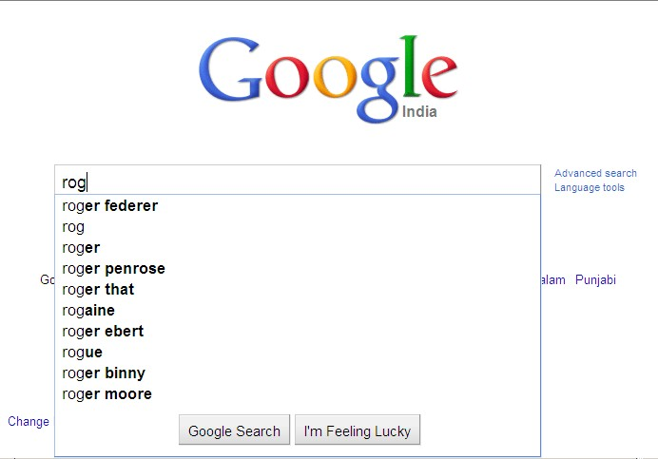
Nowadays:

Slide 41




The magic spell behind this is:
AJAX

Slide 42
AJAX (Asynchronous JavaScript And XML) is a set of technologies that facilitates the creation of more interactive websites. With AJAX we can communicate with the backend and update the website without having to refresh the page. This makes pages faster Works on standard technologies, without the need for Flash plugins

Slide 43


A BIT OF HISTORY
Internet Explorer introduced the concept of an IFrame element in 1996 (a technique that helps load the content of a Web page).
In 1998, Microsoft introduced another technique, called "Microsoft's Remote Scripting" as a replacement for the older techniques.

Slide 44

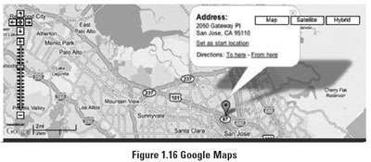
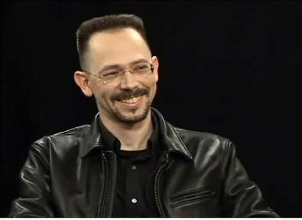
A year later, in 1999, Microsoft introduced the XMLHttpRequest object, an ActiveX control, into IE 5.
The term AJAX was coined on February 18, 2005 by Jesse James Garret in a short essay published a few days after Google launched its Maps app.

Slide 45


Finally, in 2006, the W3C (World Wide Web Consortium) announces the release of the first draft that includes the object specification (XHR) and makes it an official web standard.
Conclusion: We had to wait 10 years to have a great technology available because of the Browse War!

Slide 46
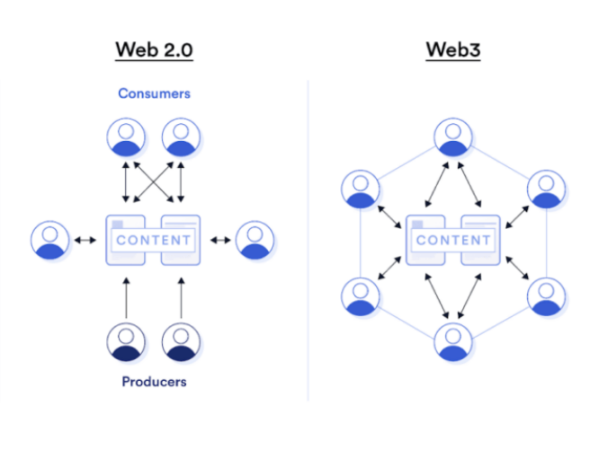
What problems do we encounter with the architectures for the metaverse?
Web 2.0 -> Centralised -> Client-server Bottelneck
Web 3.0 -> Descentralised -> Metarverse needs to be centralized
What are the consequences of centralised metaverse?
What could we do with web 3.0, Decentralised Metaverse?

Slide 47
Use cases for Metaverse?
How can companies benefit (profit) from it?

Slide 48

Conclusion:
In the future, computers will process and store elsewhere, 5G and IoT will be everywhere, potentially databases will be decentralised, and the Metaverse will be a real thing... understanding the use cases of all these new technologies for companies and specially for Fintech is key today.

Slide 49
FINTECH: REVOLUTIONIZING FINANCIAL SERVICES VIA DESIGN AND TECHNOLOGY
Data and Business Analytics
SE SSI O N S 13 & 14
Demystifying blockchain and cryptocurrency - Crypto 101
Manoel Gadi
Fall 2022

